Slide 1
User Manual
My HTA Application

Slide 2
Table Of Contents
Main Page Navigation Page 3
Main Page Navigation to Process Viewer Page 4
Attachments for Forms, ETC Page 5
Adding Records in Process Viewer Page 6
Viewing/Editing Previously Added Records Page 7
Editing Records Page 8
Searching the Records(AND / OR) Information Page 9
Searching instructions and Autocomplete Page 10
Export to Excel Page 11

Slide 3

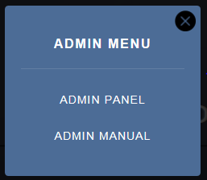
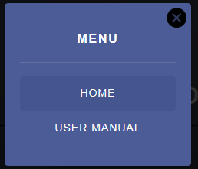
Main Page
This Explains a simple possible example of the main page of the application.
Starting from the top of the left hand side.
This button only shows up if you are an administrator.
It brings up a navigation panel for administrators.
The button on the right shows up for everybody and it
opens a navigation panel where people can refresh and
go to the main page, and open this user documentation
Now I will show you both navigation panels.
Administrators can get to the admin panel on the left and get assistance through a dedicated manual on the left. While everyday users can always go to the main page or view the user manual on the right.

Slide 4
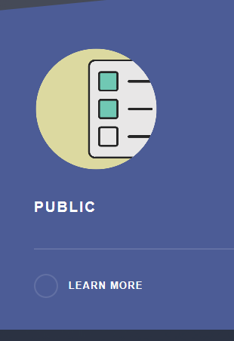


Main Page
This Explains a simple possible example of the main page of the application.
Lets move onto an example of what can be done with processes.
I will be using this public process for example. When we click on this process we are redirected to the process viewer where we can see the tables created for that process.
We can add new rows to the tables by clicking on elements like the Application Type example to the right. Or we can view, edit or even delete rows by clicking on the boxes in the table viewer area.

Slide 5
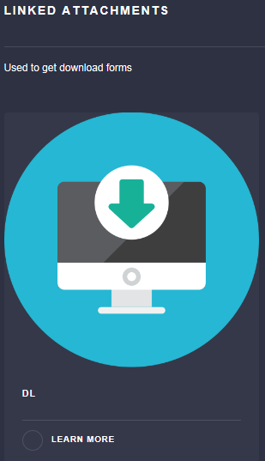
Main Page
This Explains a simple possible example of the main page of the application.
Lets move onto downloading forms and other required documents.
Downloading forms and documents is super easy all you have to do is click on the image or the learn more then it opens or downloads depending on the file type. PDF’s usually open in internet explorer.

Slide 6

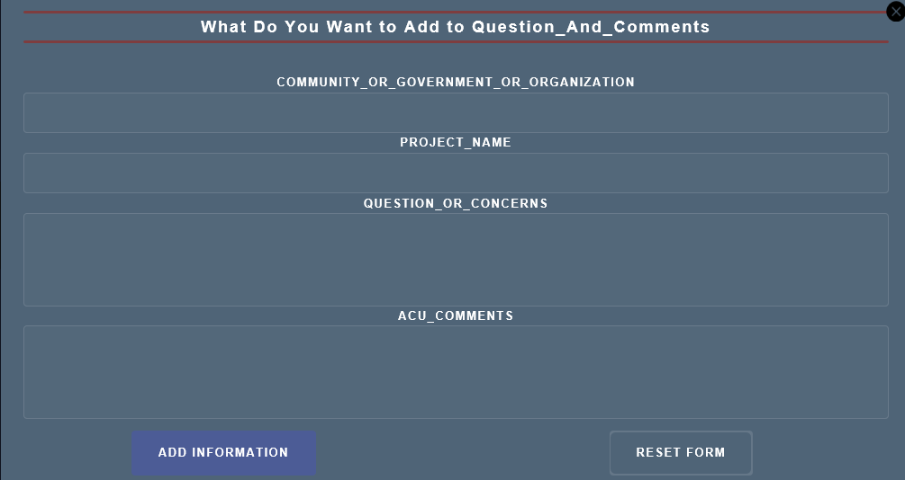
Process Viewer
This Explains a simple possible example of the process viewer of the application.
Let’s have a look at a example table
Adding data to a table is super easy easy all you have to do is click on the image or the learn more then it opens a form that the user can fill out. The text boxes on the form then click on the add information button. You also get a special popup table for when you are typing into a date box. Shown by MM/DD/YYYY in the entry field.

Slide 7
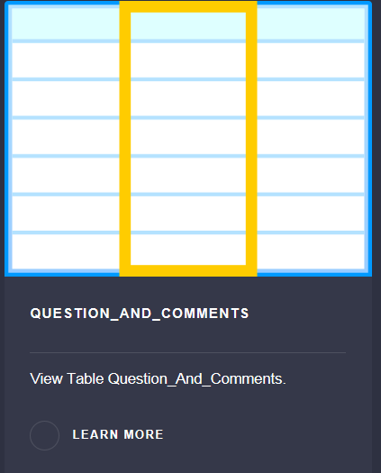
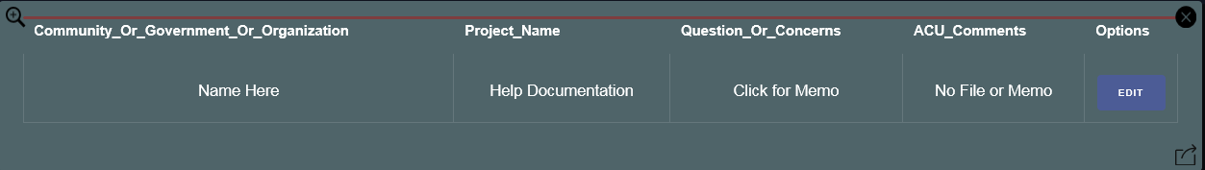

Process Viewer
This Explains a simple possible example of the process viewer of the application.
Let’s have a look at a example table
Editing data to a table is super easy easy all you have to do is go down to the table viewer section of the page. Then just click on the image or learn more link to open a table.
Search Table Here
Click for Edit Window
Click for Memo Window
Export Table to Excel Here
Memo Window

Slide 8
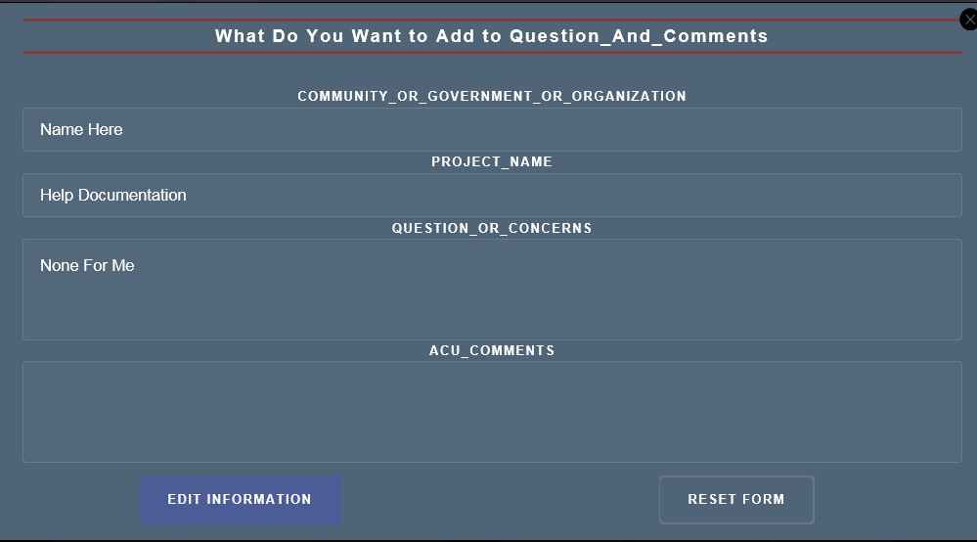

Process Viewer Continued
This Explains a simple possible example of the process viewer of the application.
Let’s have a look at editing rows of information.
Edit Row Information
After you click the edit button the form that you used to create the content is automatically filled and is ready to be edited by the user.

Slide 9
Process Viewer Continued
This Explains a simple possible example of the process viewer of the application.
Let’s have a look at the Question And Comments Table
Searching A Table
When it comes to searching a table a user might require to search for specific sets of information. Which is why you can search the table using both AND / OR. However these tools have a very specific order of operations similar to BEDMAS from Mathematics. Here I will give an examples on how this order of operations work.
Examples(More can be found HERE)
Consider we have a Rooster, Cow, Horse, Chicken, Lamb and a Turkey in a animal table. We can get them all by saying I want the Rooster and the Cow and the Horse…(Etc.)
Say we want to have all the animals that start with a “C” or a Lamb. The search first finds all animals that start with a “C” the finds the lamb.
Where we get the Cow, Chicken and the Lamb.
Say we want to have all the animals that start with a “C” and ends with a “N” or a Lamb. The search first finds all animals that start with a “C” and end with an “N” then it finds the Lamb.
Where we get the Chicken and the Lamb.
When we are searching a table grey outlined text box represents AND
And a text box outlined in a light brown represents OR.
We choose whether we want AND / OR after we select the column we are using to search.

Slide 10
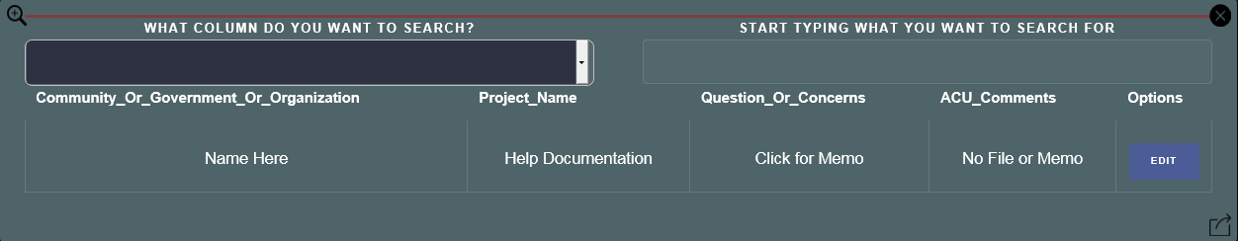
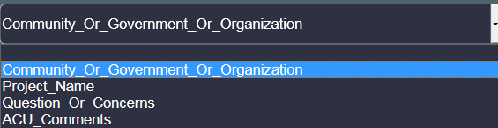


Process Viewer Continued
This Explains a simple possible example of the process viewer of the application.
Let’s have a look at the Question And Comments Table
Search Table Here
In the Drop Down menu you can select from the available columns in the table to search the table. Let’s select the first option. Now as we start typing our search we see a suggestion box appear which is filled with data from the table. As the user writes what’s in the suggestion box changes. We can select what is in the suggestion box to complete to autofill the whole box with the suggestion. Can be used with Export to Excel option.

Slide 11



Process Viewer Continued
This Explains a simple possible example of the process viewer of the application.
Let’s have a look at Exporting a Table to excel.
Export Table to Excel
When exporting tables to excel. You can either export all the columns or columns that have been selected through check boxes. If you are exporting all the columns just click on export all. If you want to export certain columns just click on the circle next to the Export labels. You also don’t need to check the Don’t Export boxes if you plan to export selected. The Don’t Export check boxes are only their if you accidently select export for one column.
All this can be done with a simple mouse click of the export symbol.

